Slide 1
Lesson 5
Using SQL Statements Within a PL/SQL Block

Slide 2
Objective
After completing this lesson, you should be able to do the following:
  Determine the SQL statements that can be directly included in a PL/SQL executable block
  Make use of the INTO clause to hold the values returned by a SQL statement
  Manipulate data with DML statements in PL/SQL
  Use transaction control statements in PL/SQL
  Differentiate between implicit cursors and explicit cursors
  Use SQL cursor attributes

Slide 3
Lesson Agenda
  SQL statements in PL/SQL blocks
  Manipulating data with PL/SQL
  Introducing SQL cursors

Slide 4





SQL Statements in PL/SQL
DDL
DML
  SQL consists of three sub-languages:
    DDL
    DML
  DDL statements are generally not included in PL/SQL blocks.
  DML statements are included in PL/SQL blocks.
SQL
Notes:
Java SE 8 Programming 2 - <number>

Slide 5


SQL Statements in PL/SQL
  SELECT command to retrieve data into the PL/SQL block.
  DML commands to make changes to the database.
  COMMIT, ROLLBACK, or SAVEPOINT commands for transaction control.

Slide 6

SELECT Statements in PL/SQL
  The INTO clause is required.
  Queries must return only one row.
DECLARE
v_fname VARCHAR2(25);
BEGIN
SELECT first_name INTO v_fname
FROM employees WHERE employee_id=200;
DBMS_OUTPUT.PUT_LINE(' First Name is : '||v_fname);
END;
/

Slide 7

Retrieving Data in PL/SQL: Example
Retrieve hire_date and salary for the specified employee.
DECLARE
v_emp_hiredate employees.hire_date%TYPE;
v_emp_salary employees.salary%TYPE;
BEGIN
SELECT hire_date, salary
INTO v_emp_hiredate, v_emp_salary
FROM employees
WHERE employee_id = 100;
DBMS_OUTPUT.PUT_LINE ('Hire date is :'|| v_emp_hiredate);
DBMS_OUTPUT.PUT_LINE ('Salary is :'|| v_emp_salary);
END;
/

Slide 8

Retrieving Data in PL/SQL
Return the sum of salaries for all the employees in the specified department.
Example:
DECLARE
v_sum_sal NUMBER(10,2);
v_deptno NUMBER NOT NULL := 60;
BEGIN
SELECT SUM(salary) -- group function
INTO v_sum_sal FROM employees
WHERE department_id = v_deptno;
DBMS_OUTPUT.PUT_LINE ('The sum of salary is ' || v_sum_sal);
END;
/

Slide 9
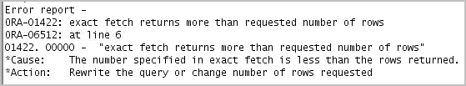
Naming Ambiguities
DECLARE
hire_date employees.hire_date%TYPE;
sysdate hire_date%TYPE;
employee_id employees.employee_id%TYPE := 176;
BEGIN
SELECT hire_date, sysdate
INTO hire_date, sysdate
FROM employees
WHERE employee_id = employee_id;
END;
/

Slide 10
Avoiding Naming Ambiguities
  Use a naming convention to avoid ambiguity in the WHERE clause.
  Avoid using database column names as identifiers.
  The names of local variables and formal parameters take precedence over the names of database tables.
  The names of database table columns take precedence over the names of local variables.
  The names of variables take precedence over the function names.

Slide 11


Using PL/SQL to Manipulate Data
Make changes to database tables by using DML commands:
  INSERT
  UPDATE
  DELETE
  MERGE
UPDATE
INSERT
UPDATE
MERGE

Slide 12
Insert Data: Example
Add new employee information to the EMPLOYEES table.
BEGIN
INSERT INTO employees
(employee_id, first_name, last_name, email,
hire_date, job_id, salary)
VALUES(employees_seq.NEXTVAL, 'Ruth', 'Cores',
'RCORES',CURRENT_DATE, 'AD_ASST', 4000);
END;
/

Slide 13
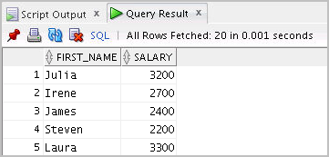

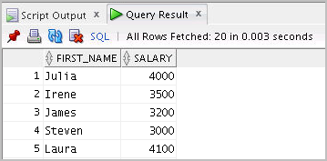
Update Data: Example
Increase the salary of all employees who are stock clerks.
SELECT first_name,salary
FROM employees
WHERE job_id = 'ST_CLERK';
/
DECLARE
v_sal_increase employees.salary%TYPE := 800;
BEGIN
UPDATE employees
SET salary = salary + v_sal_increase
WHERE job_id = 'ST_CLERK';
END;
/
SELECT first_name,salary
FROM employees
WHERE job_id = 'ST_CLERK';

Slide 14
Delete Data: Example
Delete rows that belong to department 10 from the employees table.
DECLARE
v_emp employees.employee_id%TYPE := 176;
BEGIN
DELETE FROM employees
WHERE employee_id = v_emp;
END;
/

Slide 15
Merging Rows
Insert or update rows in the copy_emp table to match the employees table.
BEGIN
MERGE INTO copy_emp c
USING employees e
ON (e.employee_id = c.empno)
WHEN MATCHED THEN
UPDATE SET
c.first_name = e.first_name,
c.last_name = e.last_name,
c.email = e.email,
. . .
WHEN NOT MATCHED THEN
INSERT VALUES(e.employee_id, e.first_name, e.last_name,
. . .,e.department_id);
END;
/

Slide 16




SQL Cursor
  A cursor is a pointer to the private memory area that stores information about processing a specific SELECT or DML statement.
  There are two types of cursors:
    Implicit: Created and managed by PL/SQL
    Explicit: Created and managed explicitly by the programmer
Implicit Cursor
Explicit Cursor

Slide 17
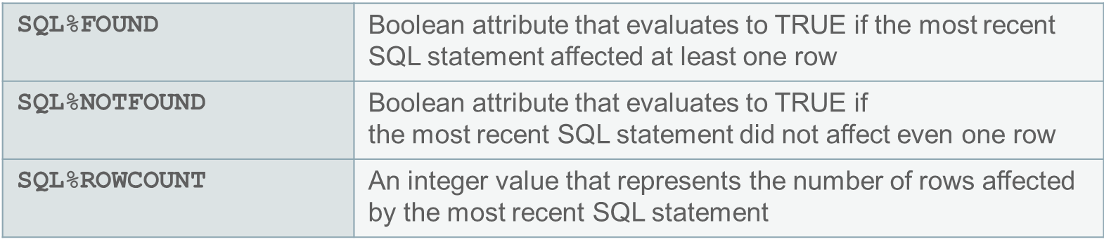
SQL Cursor Attributes for Implicit Cursors
Using SQL cursor attributes, you can test the outcome of your SQL statements.

Slide 18
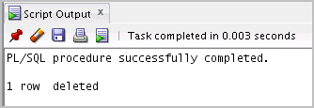
SQL Cursor Attributes for Implicit Cursors
Delete rows that have the specified employee ID from the employees table. Print the number of rows deleted.
Example:
DECLARE
v_rows_deleted VARCHAR2(30);
v_empno employees.employee_id%TYPE := 165;
BEGIN
DELETE FROM employees
WHERE employee_id = v_empno;
v_rows_deleted := (SQL%ROWCOUNT ||
' row deleted.');
DBMS_OUTPUT.PUT_LINE (v_rows_deleted);
END;

Slide 19
Quiz
When using the SELECT statement in PL/SQL, the INTO clause is required and queries can return one or more rows.
  True
  False

Slide 20
Summary
In this lesson, you should have learned how to:
  Embed DML statements, transaction control statements, and DDL statements in PL/SQL
  Use the INTO clause, which is mandatory for all SELECT statements in PL/SQL
  Differentiate between implicit cursors and explicit cursors
  Use SQL cursor attributes to determine the outcome of SQL statements

